Slide 1
Incarceration Rates Of Black Prisoners
By: Jalen Artis

Slide 2
Topic
Specifically look at the overall number of sentenced prisoners by race
Dive into the specific section of drug possession charges
Based off question from the Racial Issues IQ Quiz
Find any data that suggests Black people are more likely to be incarcerated than White people
Find any linkages or correlations between drug charge sentencing and Black people.
Question: How much prison time do African-Americans receive for drug and weapons violations compared to whites convicted of the same crime?

Slide 3
Questions
1. What is the percent of sentenced Black prisoners compared to the percent of sentenced white prisoners in 2011-2021?
2. What is the percent of sentenced White male prisoners and Black male prisoners to the total sentenced male prisoner population? Which rate is higher?
3. What is the percentage of incarcerated Black people with drug charges compared to the other races with drug charges from 2014-2019?

Slide 4
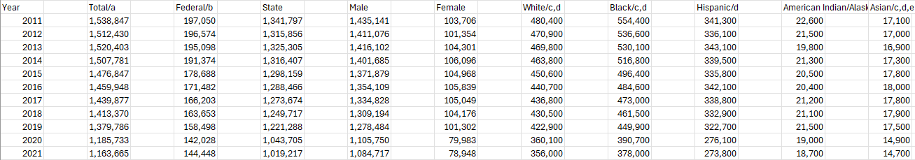
Data
Bureau of justice statistics Prisoners in 2021 – Statistical Tables
Sentenced prisoners under the jurisdiction of state or federal correctional authorities, by jurisdiction, sex, and race or Hispanic origin, 2011–2021

Slide 5
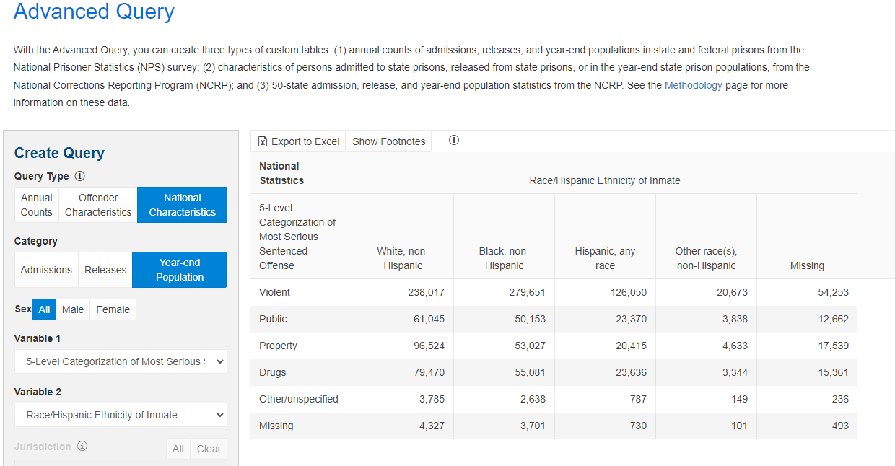
Data
Bureau of justice statistics, Corrections Statistical Analysis Tool (CSAT) - Prisoners
National Statistics of prisoner population categorized by the 5 level most serious offense and race/ethnicity of prisoner

Slide 6
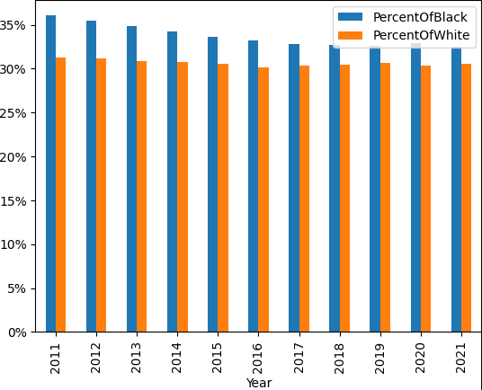
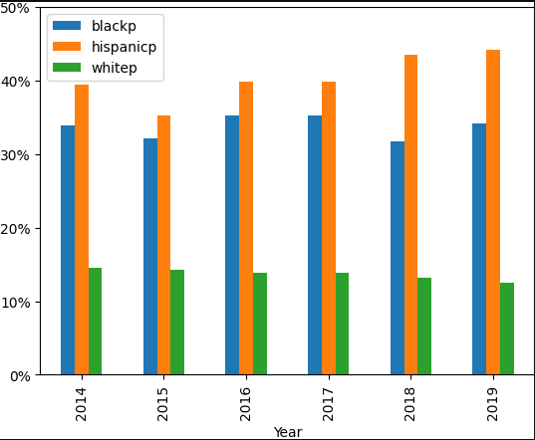
Results
https://trinket.io/python3/5f025d0d02
https://trinket.io/python3/0778d037f2
Notes:
The first chart is for the first question:(What is the percent of sentenced Black prisoners compared to the percent of sentenced white prisoners in 2011-2021?) You can see the percentage of Black prisoners is greater than the percentage of White prisoners from 2011-2021
The second chart answers the third question:(What is the percentage of incarcerated Black people with drug charges compared to the other races with drug charges from 2014-2019?) You can see the percentage of Hispanic prisoners is highest with the percentage of Black prisoners following from 2014-2019

Slide 7
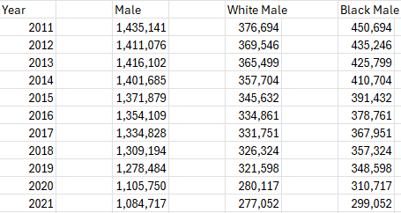
Results
Results conclude the population of incarcerated Black males surpasses the population of White males from 2011-2021
Notes:
Concluding from the data, the question arises: Are black people facing discrimination?

Slide 8
Works Cited
Bureau of Justice Statistics
Filename: p21stt03.csv
Table 3. Sentenced prisoners under the jurisdiction of state or federal correctional authorities, by jurisdiction, sex, and race or Hispanic origin, 2011–2021
Report title: Prisoners in 2021 – Statistical Tables NCJ 305125
Data Source: Bureau of Justice Statistics, Federal Justice Statistics Program, 2021 (preliminary); National Corrections Reporting Program, 2020; National Prisoner Statistics, 2011–2021; Survey of Inmates in State and Federal Correctional Facilities, 2004; and Survey of Prison Inmates, 2016
Author: E. Ann Carson, PhD, BJS Statistician
Date of version: 12/20/2022
Accessed: 2/25/2024
https://bjs.ojp.gov/library/publications/prisoners-2021-statistical-tables#0-0

Slide 9
Works Cited
Bureau of justice statistics
Corrections Statistical Analysis Tool (CSAT)
National Characteristics, Year-end Population, 5-level categorization of most serious sentenced offense:Race/Hispanic Ethnicity of Inmate, 2014-2019
Accessed 02/25/2024
ttps://csat.bjs.ojp.gov/advanced-query

